Slide 1

EasyX10 Project
CS673 –Software Engineering
Fall 2008
Notes:
Last Updated 12-14-08 – 12noon - BED

Slide 2




Project Overview
The Problem
Design a solution to control home lighting or other appliances that can be managed from anywhere in the world via a web-based interface.
Notes:
Bruce

Slide 3
Project - Goals
Implement a Web-based Interface
  Userid and password login
  Icon based device management
Integrate existing control technologies
  X10 Protocol (home power line)
  CMA11 Control Module
  TM751 wireless transceivers for Motion Detectors
  X10 Appliance modules and motion detectors
Build on an Open-Source Platform
  Java and JavaScript Libraries
  RXTX Serial API
  xStream Serialization Library
  Tomcat Web Server
  Google SVN Software Repository
Make the solution easy to setup and manage for the average home-owner
Notes:
Bruce

Slide 4
Major Requirements
Manage Persistent Data
Manage Users (Login/Logout)
Add X10 Devices
Remove X10 Devices
Report Status of X10 Devices
Modification and Control of X10 Devices (i.e. State Changes)
Accept X10 Events (i.e. Process Motion Detection)
Process timer Events (i.e. Turn Device on/off at Selected Time)
Notes:
-Bruce

Slide 5
Project - Constraints
Deliver software functionality based on team member’s experience with the technologies and existing market solutions
Limited functionality in the 1st product release, due to class schedule, and the time constraints of regular full-time jobs and family demands
Leverage the existing software development expertise of team members rather than have a steep learning curve with new technologies
Use Waterfall model for Software Development
Notes:
Bruce

Slide 6
Platform Details
Machine running Tomcat Web Server
Locally attached CM11A Controller
Appliance modules plugged into house power line
Wireless transceiver attached to power line
Wireless motion sensors
Client PC running Firefox Web Browser
Notes:
Bruce

Slide 7
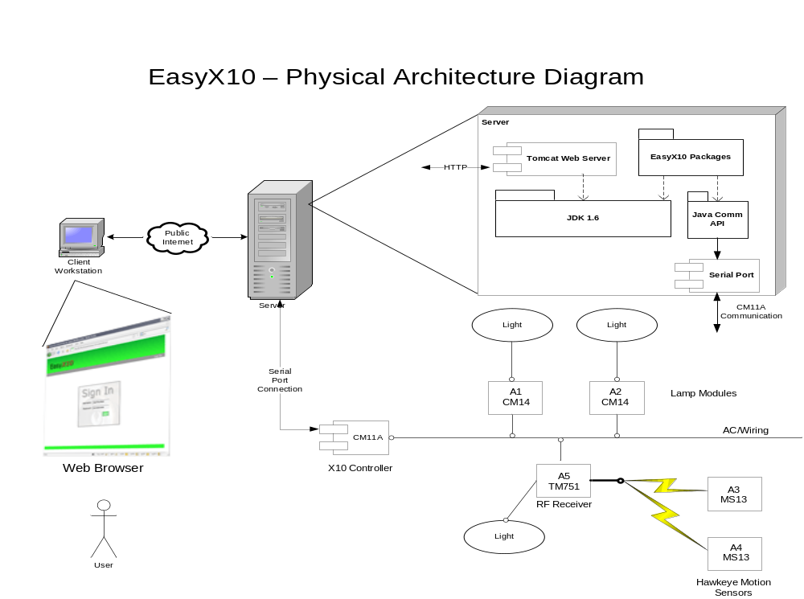
Physical Architecture
Notes:
Bruce

Slide 8
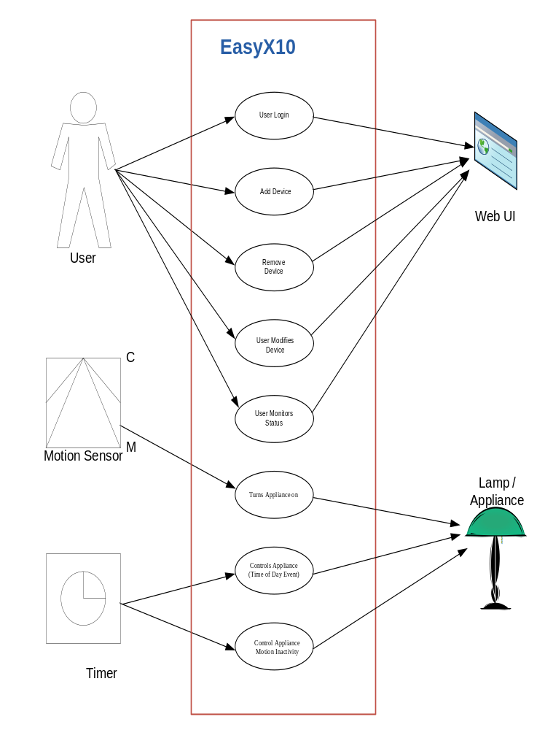
Use Cases
User Login
Add Device
Remove Device
Modify Device
Monitor Status
Time of Day Control
  On/Off Appliance
Motion Detection
  On/Off Appliance
Notes:
Bruce
Talk about each one.

Slide 9
Potential Functionality for Future Releases
Database integration of configuration parameters
More robust Authentication solution
Administrative Menu’s to allow easier setup of system users.
Installation and setup Guide
Implement additional X10 device types
Support additional protocols (TCP/IP, Insteon)
Notes:
Bruce

Slide 10

Software Design and Construction
Notes:
John

Slide 11
Design - Highlights
Model View Controller (MVC) Architecture
Other Architectures considered
  Layered
  Plugin
Factory and Observer Design Patterns
Java Programming Language
Industry Standard X10 API
Notes:
John
-Used Factory pattern to simulate a Singleton Design Pattern

Slide 12
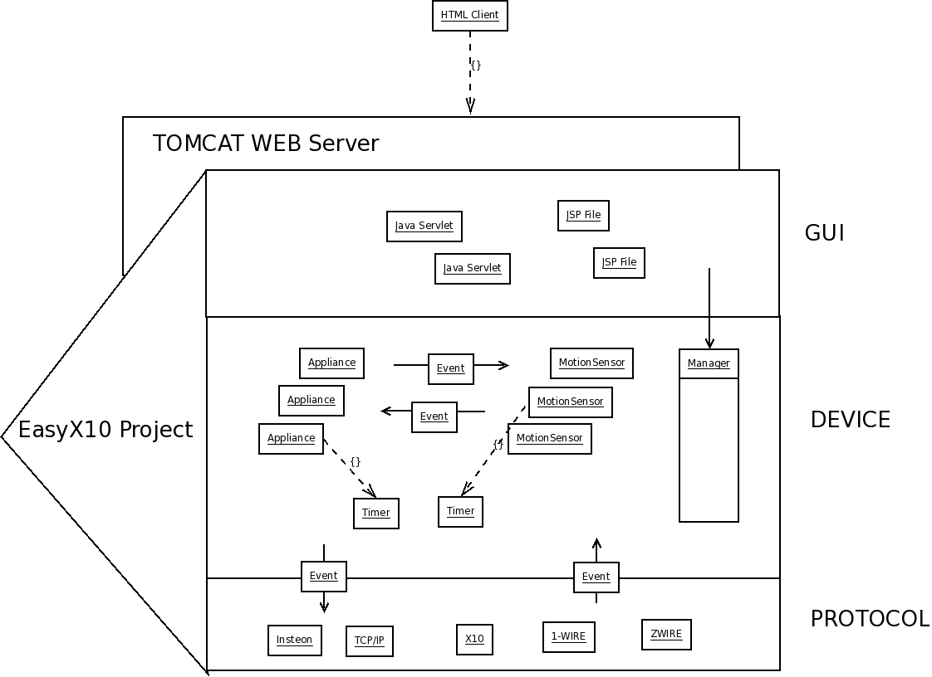
Architecture Overview
Notes:
John

Slide 13
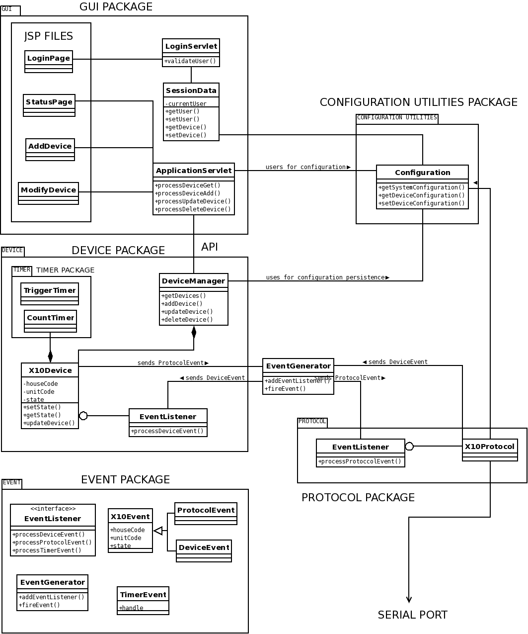
System Class Diagram
Notes:
John

Slide 14
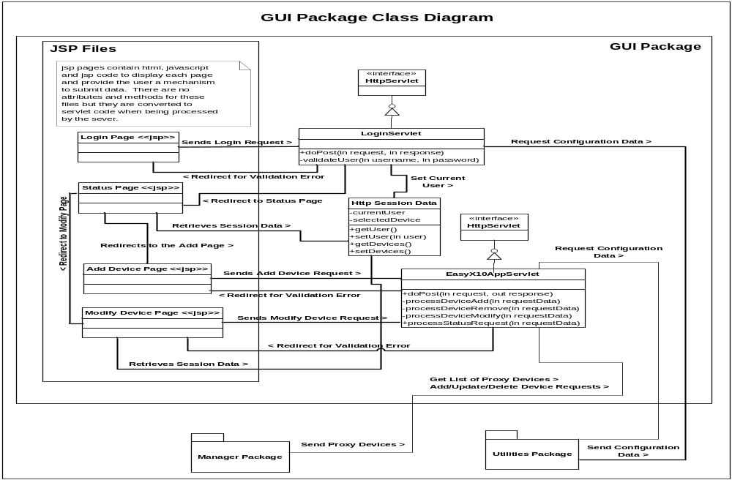
GUI Package Details
Notes:
John section to discuss

Slide 15
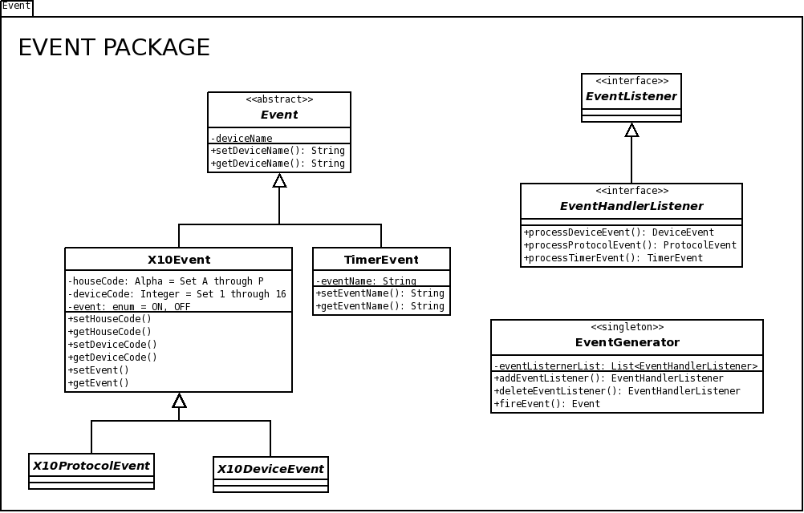
Event Package Details
Notes:
Jim section to discuss

Slide 16
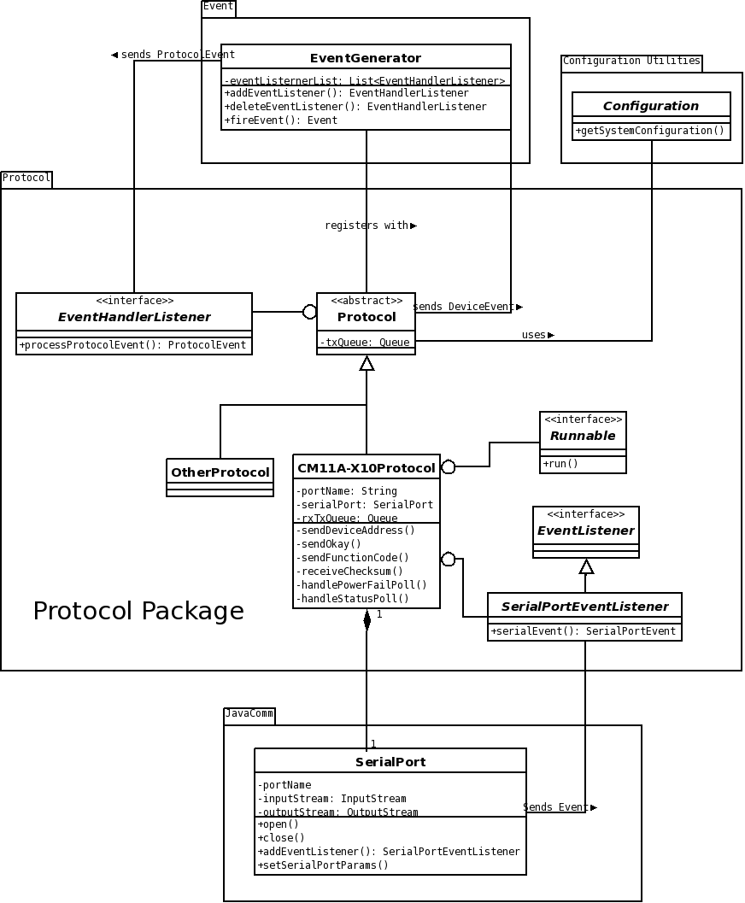
Protocol Package Details
Notes:
Jim section to discuss

Slide 17
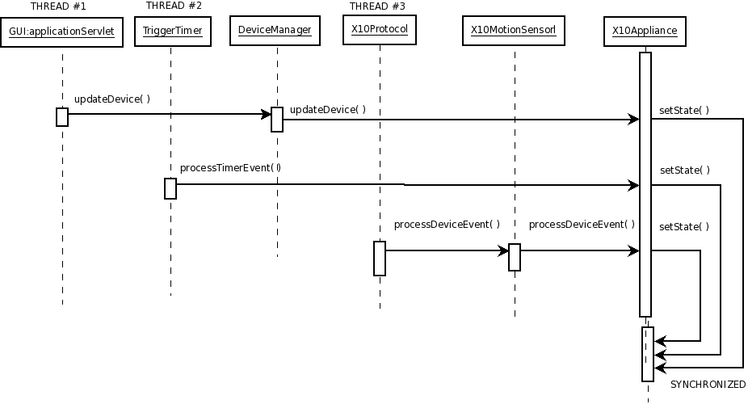
Concurrency Design
Notes:
Jim to discuss

Slide 18
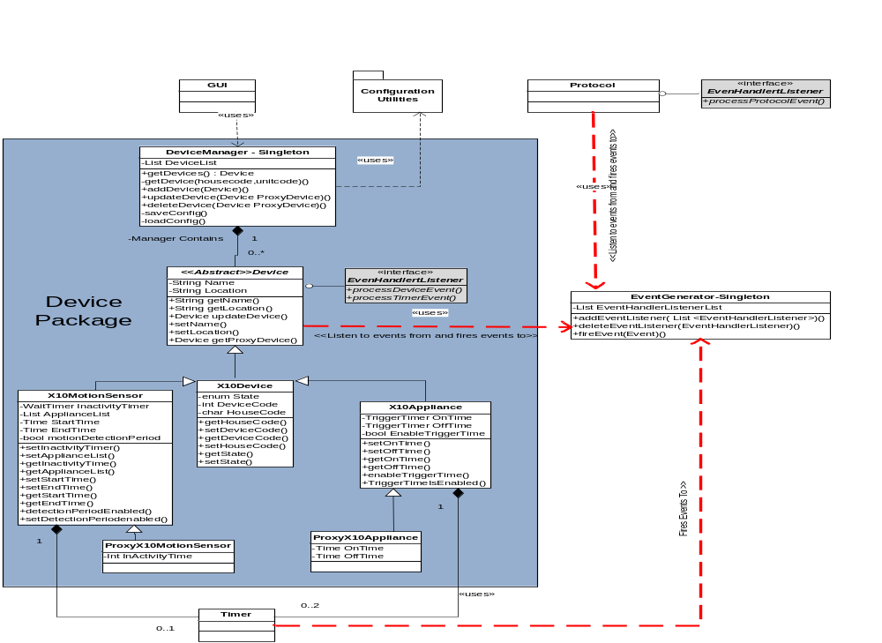
Device Package Details
Notes:
Damon package to discuss

Slide 19
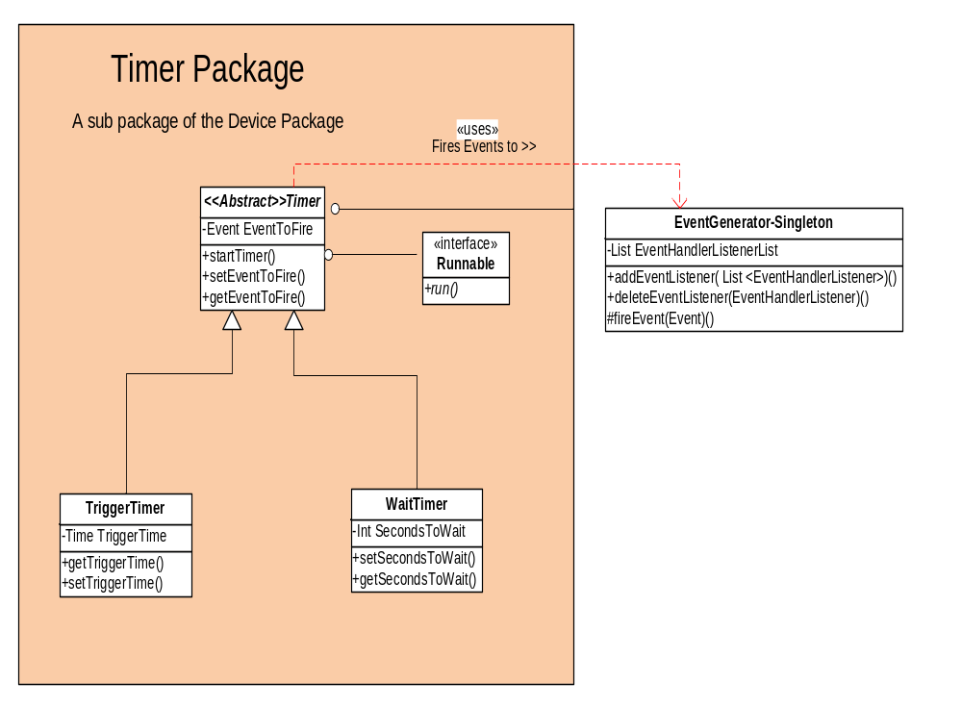
Timer Package Details
Notes:
Damon package to discuss

Slide 20
Design Changes
Switched from Singleton to Factory Pattern
Switched from Directed Observer Pattern to Event Bus Observer Pattern
Introduced Proxy Device concept
Notes:
Damon will do this
Switched from singleton to factory pattern to allow for better testing
Switched to Event Bus Pattern to simply the registration of devices within the application
Proxy Device allowed us to use layered abstraction with the design – so we had a single point of “setting state for a device

Slide 21
Implementation Issues
Hardware Issues
  Defective CM11A controller device
Operating System Issues
  Java serial API vs. RXTX API
Deployment Issues
  RXTX Library Path
Operational vs. Test environment
  XML configuration file differences
  File path locations
Notes:
Damon talks this slide
Operating System Issues- each developer had to develop on diff operating system.
Detecting RXTX Library Path on each developer’s operation system
XML config file – initially didn’t generate location info – this was discovered during integration testing

Slide 22

Group Process
“It was a Hard Days Night”

Slide 23
Project Team Operational Guidelines
3 meetings per week
  Tuesday night after class - planning
  Thursday night phone call – status meeting
  Sunday afternoon - 2 hr live meeting Waltham
Developed Project Schedule
Published Meeting Agenda and Minutes
Waterfall Development Process Model
Leveraged Google Code (SVN)
  Artifact Management (Code and HW documents)
Leveraged Google Groups
  Team communication and change management
Notes:
John
735 messages were exchanged between project team members
-
-
-
-John talks this slide
-John
-describe overall project process
-WIKI

Slide 24
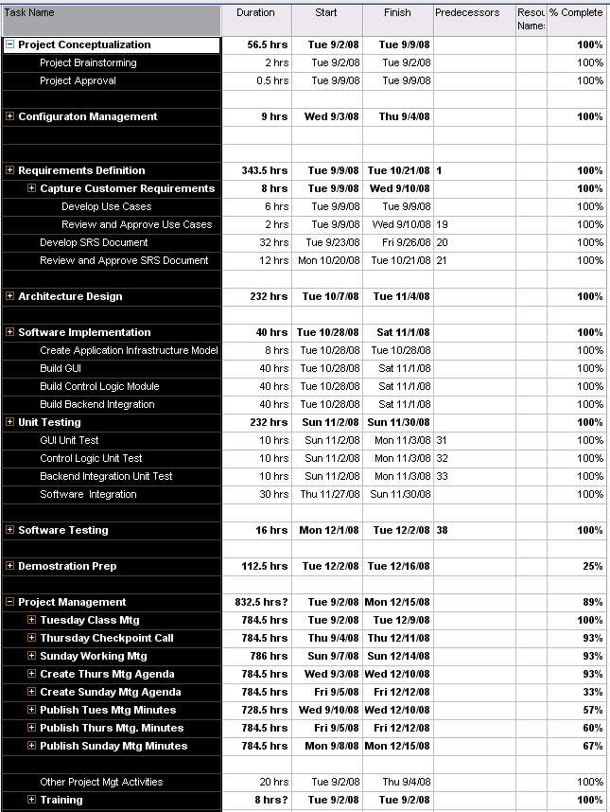
Project Schedule
Notes:
John
Discuss the various steps in the schedule
Schedule was defined by the Class Schedule deliverables.

Slide 25


Project Postmortem

Slide 26
Postmortem Overview
Successes
  The Team Work
  The Diagrams
  The SRS and SDD Artifacts
  The Code
Challenges and Improvements
Next Time I would …
Lessons Learned
Notes:
Damon

Slide 27
Project Team – Success Factors
Supporting one another throughout the process
No interpersonal conflict
Leveraging individual expertise
Effective Communication
Consistent on time deliverables
Configuration management strategy
Good Design
Notes:
Damon
Jim’s knowledge of X10
John’s knowledge of GUI design, Google Groups and SVN
Good Design – class structure forced us to be more through

Slide 28
Project Team – Challenges
Balancing schedules due to:
  Illness of team or family members
  Out of town - Family events
  Demands of regular jobs
Learning “new” technologies for some team members:
  SVN
  Google Groups/Code
  Java
  JUnit Testing Software
Notes:
Damon

Slide 29
Project - Improvements
Transition to an Agile or Spiral Development Process Model
Develop on a single operating system
More time for Unit and Systems Integration Testing
Use formal defect tracking system
Acquire additional hardware resources for system testing at start of project
Plan More time for 3rd Party API integration
Notes:
Bruce

Slide 30
Next Time I would…
Spend more time on initial prototyping
Do more code reviews
Use a Spiral Development process model
Use a Test-First Development strategy
Plan for a higher number of code defects
Do more formal defect tracking
Use more effective debugging tools
Notes:
Bruce
If more time on prototyping – problems would be learned earlier – push defects up stream
Code Reviews would of highlighted errors sooner
Spiral Dev would have allowed us to find bottlenecks and systems issues in 1st round of development
Test-First Development would have spent less time finding bugs in system level test
We were highly optimistic on how good our code would be
Used Google groups for bug tracking – but they were just email threads

Slide 31
Lessons Learned…
Doing it “right” with the proper level of documentation takes a lot of time.
Everyone thinks differently
Hard to balance a full time job and school
Having experienced people prevented team conflict.
Requirements process was key to getting group on the same page with the design.
Class diagrams are critical to a good design
Always more bugs than you anticipate
Notes:
-Bruce
-Class diagrams-smoothes implementation, identifies design flaws earlier
-

Slide 32
Time Estimates
HW # | Milestone Deliverable | Due Date | Estimated Hours | Actual Hours
1) | Communication Plan | 9/9/08 | 20 | 35.5
2) | Software Configuration Mgt Plan (SPMP) | 9/16/08 | 32 | 39
3) | Software Project Mgt Plan | 9/23 | 35 | 44.5
4) | Software Requirements Specification (SRS) | 10/21/08 | 80 | 110
5 | Software Detailed Design Document (SDD) | 11/04/08 | 80 | 130
6 | Operational System/Prototype | TDB | 120 | 188
7 | Individual Project Assessments | TDB | 25 | 2
8 | Final Project Presentations | TDB | 40 | 15
 | Total Hours |  | 432 | 564+
Notes:
Bruce
-We did not track additional time during the final week of the project

Slide 33

Question and Answer
Please visit us: http://code.google.com/p/easyX10

Slide 34
Physical Architecture
Notes:
Bruce

Slide 35
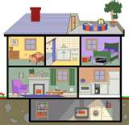
Product Demonstration
Notes:
Jim will script demo

Slide 36
Appendix
Additional info about X10 devices

Slide 37
More Information Available At…
Amazon.com
Smart Home Hacks: Tips & Tools for Automating Your House (Hacks)
by: Gordon Meyer
Smart Homes for Dummies, Second Edition
by: Danny Briere, Pat Hurley
Easy X10 Projects For Creating A Smart Home
by: Technica Pacifica
25 Home Automation Projects for the Evil Genius
by: Jerri Ledford
Absolute Beginner's Guide to Home Automation (Absolute Beginner's Guide)
by: Mark Edward Soper
X10 modules on Ebay
X10 ActiveHome PRO CM15A w BONUS SC503 Home Automation.
X10 SlimFire Keychain Remote KR19A. X10 Home Automation
X10 Home Automation Remote Chime Module (SC546)
X10 ActiveEye Motion Sensor- Home Automation MS16A
X10 Dimmable Lamp Module - Home Automation (LM465)
X10 Home Automation SlimFire Keychain Remote (KR19A)

Slide 38
To Purchase Products
X10 Hardware Stores
X10.com
  I have purchased many of my x10 modules from sales at x10.com
Radio Shack
  Radio shack sells many x10 products often labelled as "Plug n Power" home automation devices.
Smart Home
  Smart home is another retailer with a good selection of x10 components.
X10 Software Resources
X10 software is optional since many wired and wireless controllers exist, but using a software product allows for greater control of your home.
MisterHouse
  Open source X10 Control Software written in PERL.
Indigo (Macintosh)
  X10 Control software for the macintosh platform.
X10s Active Home Pro
  I currently use X10's Active Home Pro software to manage the X10 devices in my house.
Xtension
  Macintosh X10 software.

